Slide 1



IMPLEMENTATION USING MACHINE LEARNING CLASSIFIERS
ALEXANDER ILNYTSKY, HABEEB OLAWIN, UTKARSH MISHRA

Slide 2
GOAL
CREATE A LOSS-CUTTING STRATEGY WHICH OUT-PERFORMS THE PORTFOLIO HOLDINGS
MEASURE RISK OF A PORTFOLIO HOLDING
PREDICT IF NEXT DAY RETURN WILL BE POSITIVE OR NEGATIVE BASED ON DIRECTION OF STOCK PRICE MOVEMENT
IF MODEL PREDICT POSITIVE RETURN, WE BUY AND IF NEGATIVE WE SELL

Slide 3
INTRODUCTION
INVESTORS WANT TO KNOW THE FUTURE PRICE OF THEIR ASSET HOLDING
MARKET IS RANDOM
NEXT DAY RETURNS CAN’T BE EXACTLY PREDICTED DUE TO VARIOUS FACTORS
CLASSIFICATION WAS EMPLOYED
Note: For this purpose of this presentation - security, stock, or instrument mean the same thing

Slide 4
EXPLORATORY DATA ANALYSIS (EDA)
CHOSE 20 LARGEST IPOS LISTED ON NYSE AND NASDAQ BETWEEN 2014 – 2015
PULLED HISTORICAL DATA FROM BLOOMBERG FROM JANUARY 2016 – APRIL 2019
USED 13 INDEPENDENT FEATURES (INDICATORS) AND 817 OBSERVATIONS FOR EACH STOCK

Slide 5
EDA – FEATURES (TECHNICAL)
RELATIVE STRENGTH INDEX 3-DAY AND 14-DAY - tells us if the security is overbought or oversold
COMMODITY CHANNEL INDICATOR (CMCI) - similar indicator as RSI so they confirm each other
FEAR GREED - measures buying and selling strength
MOVING AVERAGE CONVERGENCE/DIVERGENCE (MACD) DIFFERENCE - if security is -ve goes from +ve to -ve we buy, and if it goes from -ve to +ve we sell
MONEY FLOW BLOCK AND NON-BLOCK - money flowing in and out for a particular security

Slide 6
EDA – FEATURES (SENTIMENTAL)
INSTITUTIONAL AND INSIDER OWNERSHIP - shows how much big institutions and insiders own for a certain security
PUT/CALL RATIO ON CURRENT DAY AND TOTAL - tells us what options traders think about the future movement of the security
IMPLIED VOLATILITY - 100% moneyness
PERCENTAGE VOLUME - ratio of volume/total shares outstanding

Slide 7
DEPENDENT VARIABLE
NEXT DAY RETURN
ASSIGNED A VALUE OF 1 IF POSITIVE
ASSIGNED A VALUE OF 0 IF NEGATIVE

Slide 8
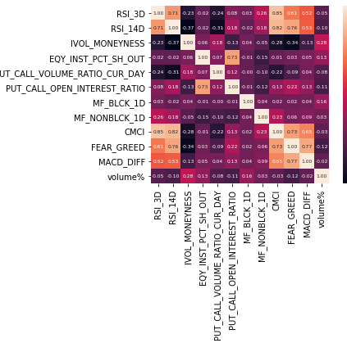
EDA - ALIBABA

Slide 9

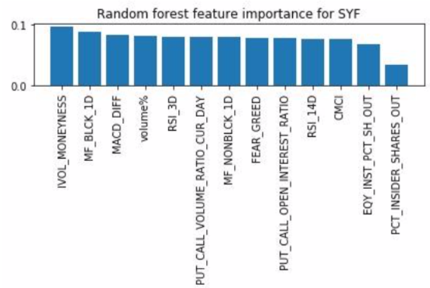
EDA – FEATURE IMPORTANCE

Slide 10
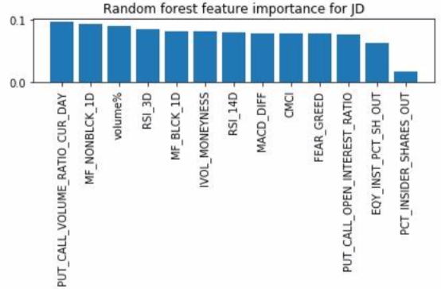
EDA – FEATURE IMPORTANCE

Slide 11
PRE-PROCESSING
80% TRAINING SET – 652 OBSERVATIONS (JANUARY 11TH 2016 – AUGUST 17TH 2018)
20% TESTING SET – 163 OBSERVATIONS (AUGUST 20TH 2018 - APRIL 16TH 2019)
STANDARDIZED THE FEATURES WITH ZERO MEAN AND UNIT VARIANCE
PERFORMED PCA TRANSFORMATION TO CONVERT POSSIBLY CORRELATED FEATURES INTO LINEARLY UNCORRELATED FEATURES CALLED PRINCIPAL COMPONENTS

Slide 12
MODELS
LOGISTIC REGRESSION
SUPPORT VECTOR MACHINE
RANDOM FOREST

Slide 13
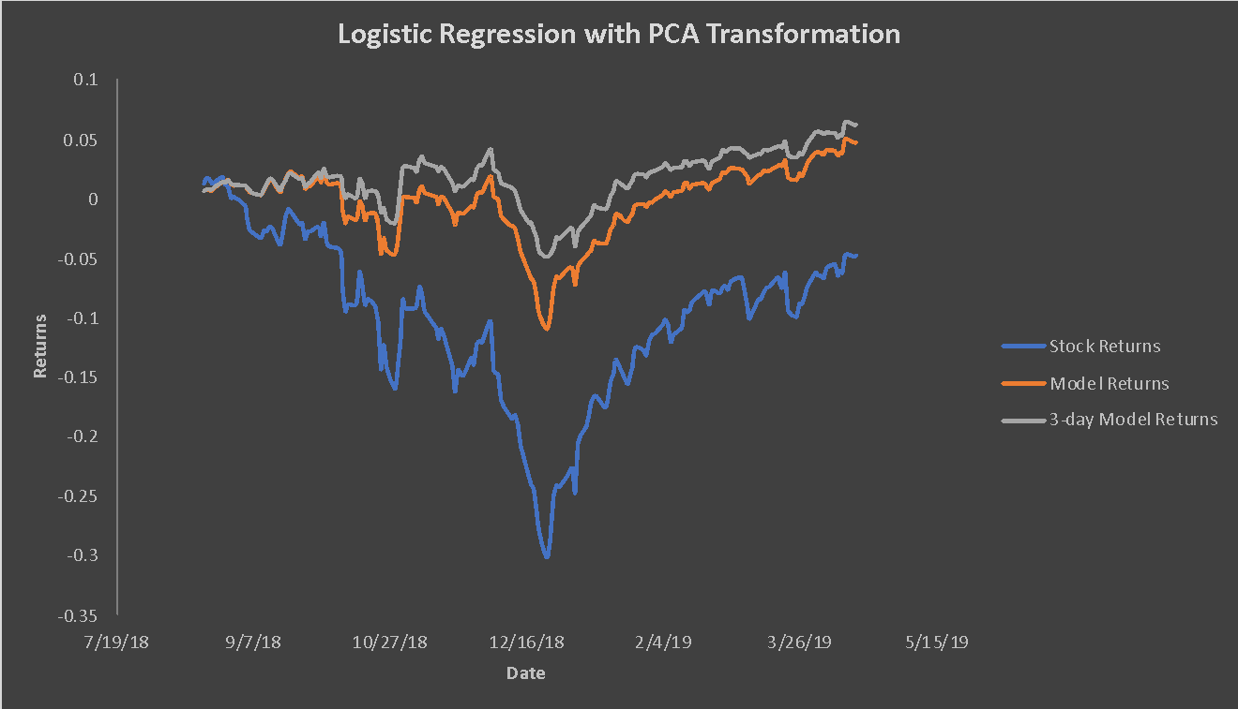
LOGISTIC REGRESSION

Slide 14
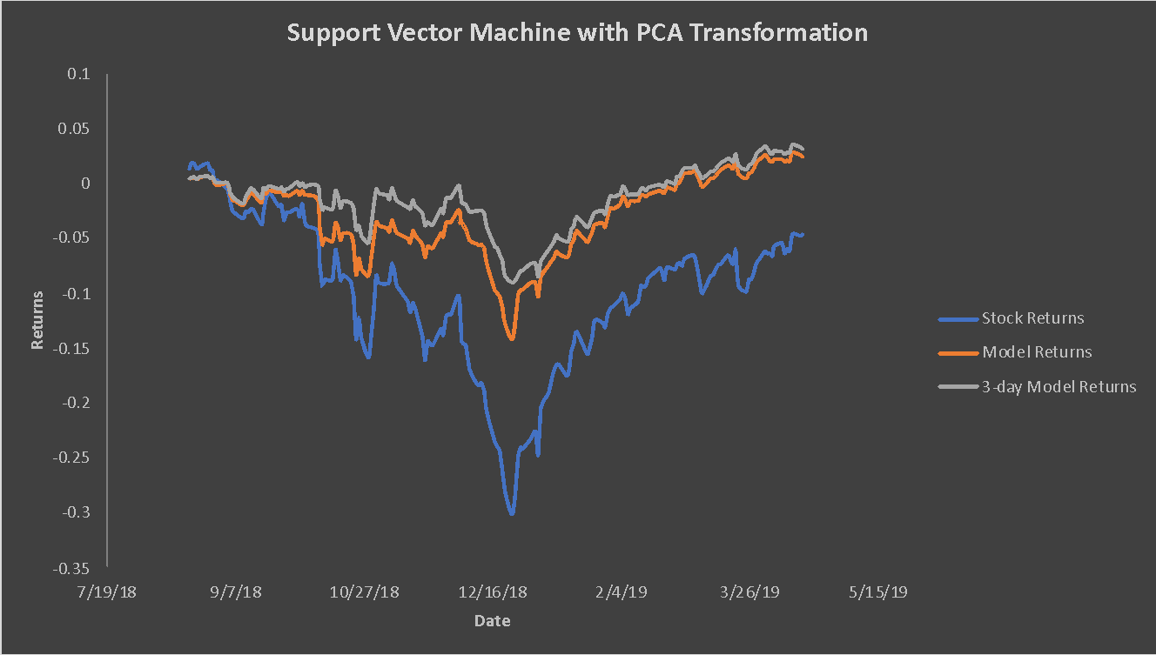
SUPPORT VECTOR MACHINE

Slide 15
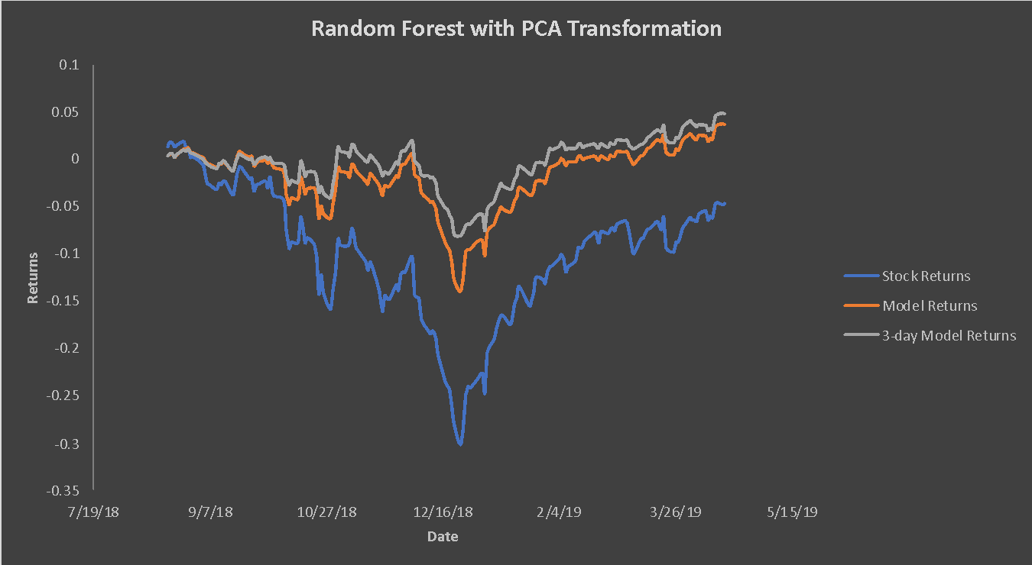
RANDOM FOREST

Slide 16
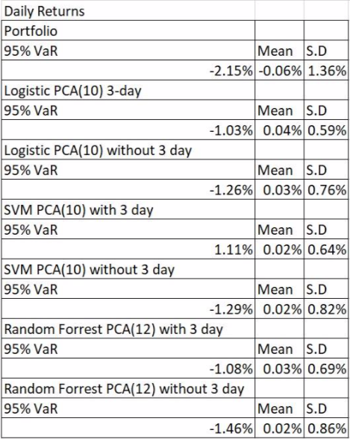
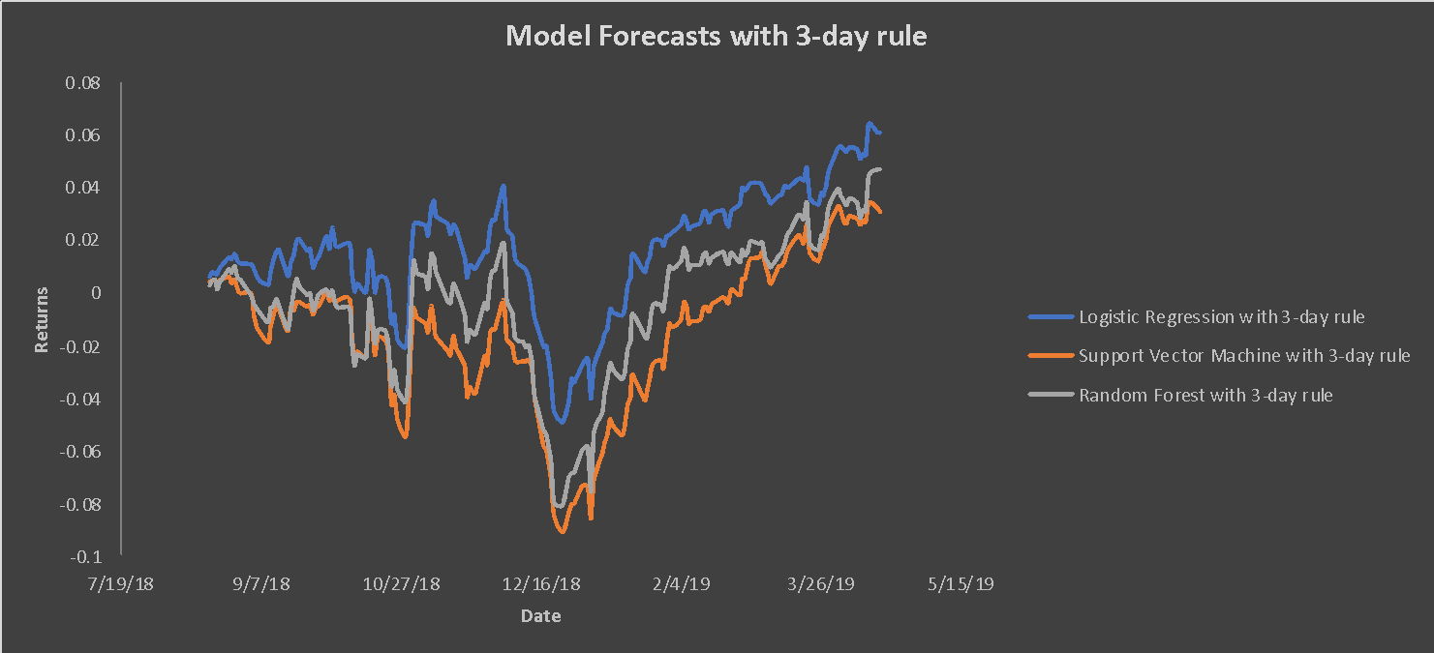
MODEL COMPARISON

Slide 17
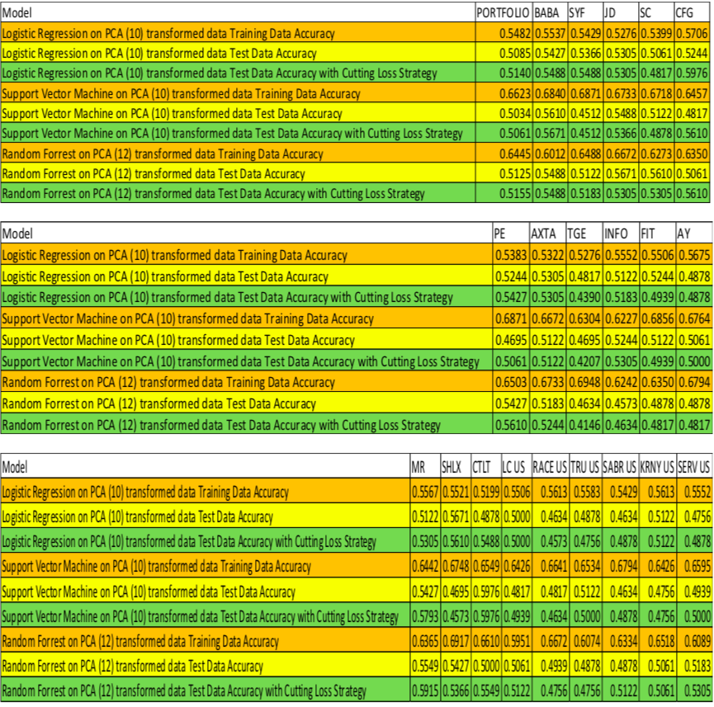
PERFORMANCE ANALYSIS

Slide 18
MODEL LIMITATIONS
ASSUMES NO TRANSACTION COST
TESTING DATA ON A FIXED PERIOD
STOCKS NEED TO HAVE TRADED OPTIONS
ENOUGH TRADING HISTORY
ARTIFICIAL STOP-LOSS CONDITION

Slide 19
CONCLUSION
MODEL CAN BE EXTENDED TO MOST TRADED SECURITIES
MORE/DIFFERENT TECHNICAL AND SENTIMENT INDICATORS CAN BE USED

Slide 20
QUESTIONS
?

